Slide 1


Slide 2
Executive Summary
LAST STEP
Project Description:
This project was initiated to address a critical workforce stability challenge at International Business Machines (IBM) Corporation. The company’s annual Attrition Rate stands at 16.12%, significantly exceeding the healthy industry benchmark and internal target of 10%.
Objectives:
To identify the key patterns driving employee attrition and provide strategic recommendations for the HR team to improve retention and job satisfaction
Tools:
Python (Pandas & NumPy): Data cleaning, aggregation, and statistical correlation
Tableau: Interactive dashboards and visual tracking of key attrition metrics.
Metrics:
Overall Attrition Rate: 16.12% (237 out of 1,470 employees resigned), placing the organization in a high-alert retention danger zone.
Employee Lifetime Value (ELV) Tenure Gap: Retained employees maintain an average tenure of 7.37 years, whereas separating employees drop off at an average of 5.13 years.
Average Commute Threshold: The mean distance from home for resigned employees is 10.63 km.
Salary Competitiveness Ratio: Lulusan Sarjana (S1) index is at 1.02 compared to the company-wide average salary, indicating strong aggregate educational pay parity.
Overtime Impact Ratio: Employees working overtime exhibit an attrition risk multiplier of 2.93x higher than non-overtime workers.
Career Promotion Lag: Employees stay stagnant in the exact same role for an average of 4.23 years, while the time elapsed since their last promotion averages 2.19 years.
Income-to-Job-Level Ratio: Calculated per department to measure internal compensation fairness relative to job responsibilities ($ / Job Level).

Slide 3
Executive Summary
LAST STEP
Analysis Result:
Attrition Rate | Data / Finding | Status
Attrition Rate | 16.12% (Target: $\le 10\%$) | ALERT
Critical Turnover Window | Avg. 5.13 years for departures | CAUTION
Commute Threshold | Avg. distance: 10.63 km | WATCH
Bachelor's Pay Ratio | 1.02 (2% above company avg.) | HEALTHY
Overtime Impact | Attrition risk surges 2.93x higher | CRITICAL
Income to Job Level Ratio | 4.23 years in role / 2.19 year promotion lag | CAUTION
Pay vs. Responsibility | HR ($3,839) & R&D ($3,843) underpaid at Level 5 | ANOMALY
Indicator | Priority | Recomendation
Burnout Mitigation | 1 | Batasi kuota lembur bulanan per karyawan, terutama bagi mereka yang memiliki metrik logistik kritis (jarak rumah > 10.63 km).
Executive Compensation Review / Adjustment | 2 | Sesuaikan kembali upah dasar Job Level 5 di HR dan R&D agar rasionya berada di atas level 4 (minimal $4,100/level) guna menjaga asas keadilan internal.
Job Rotation | 3 | Lakukan rotasi kerja lateral atau job enrichment sebelum karyawan menyentuh angka masa kerja 4 tahun di peran yang sama (YearsInCurrentRole) untuk menghindari kejenuhan karier.
Recommendation:

Slide 4
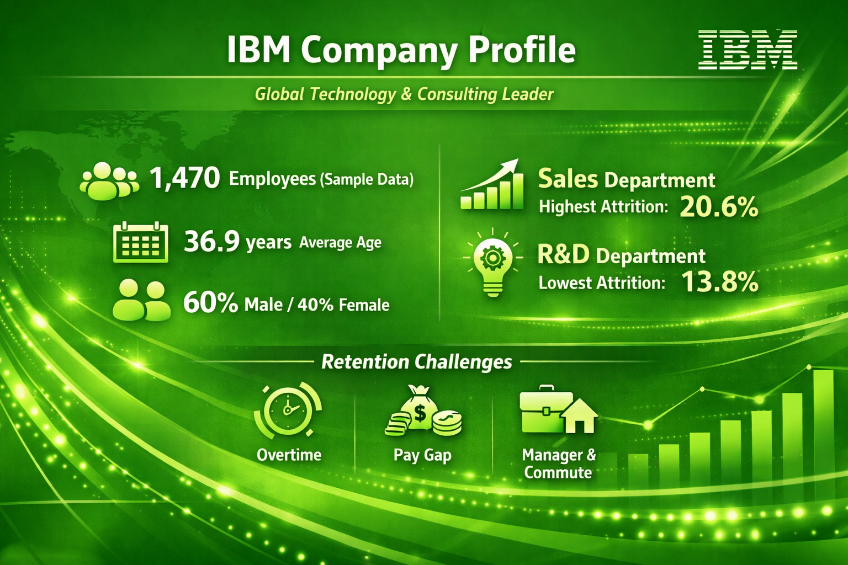
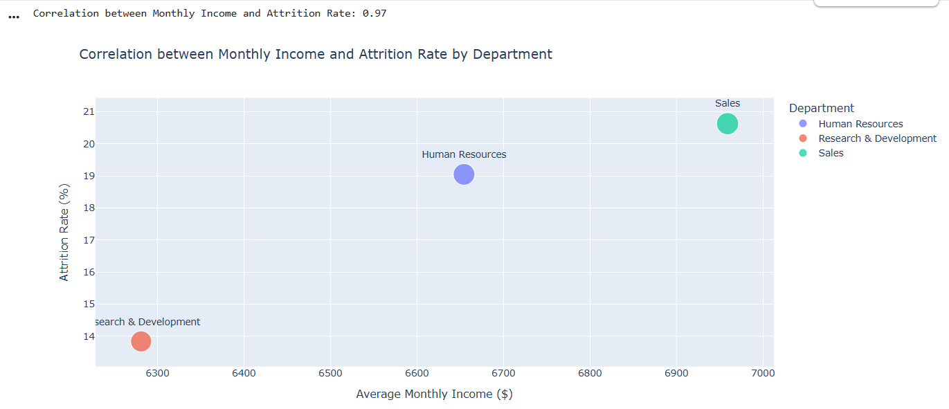
Background of Project
Income vs Attrition: Higher pay tends to lower attrition, but it’s not the only driver.
Sales Department: Despite offering the highest income, attrition remains high due to non-financial pressures such as workload and role demands.
R&D Department: Shows stronger stability with moderate pay, reflecting balanced compensation and job satisfaction.
Business Insight:
Compensation impacts attrition, but department-specific factors like workload, role clarity, and leadership are equally important. Effective retention strategies should blend fair pay practices with targeted employee engagement initiatives.
Data Source

Slide 5
Methodology
3. Exploratory Data Analysis: Profiling
Profiling & Pemahaman Variabel (Data Auditing)
Analisis Univariat (Analisis Tunggal Variabel
Analisis Bivariat (Analisis Silang Hubungan Dua Variabel)
4. Analisis Multivariat & Deteksi Efek Pengganda (Advanced EDA)
5. Data Visualization:
Visual Information
The Data-to-Ink Ratio
Pre-attentive Attributes
Chart Selection Framework
1. Problem Understanding: SMART Framework
1
2
3
4
5
6
2. Data Preparation & Data Cleaning:
Data Auditing & Profiling (Pemeriksaan Struktur Awal
Handling Missing Values (Penanganan Data Kosong)
Handling Duplicates (Penanganan Data Ganda)
Data Type & Format Standardization (Standardisasi Format)
Outlier Detection & Handling (Deteksi Data Pencilan)
4. Data Analysis:
Descriptive Analytics
Diagnostic Analytics
Hypothesis Testing
Predictive Analytics
6. Insight & Recommendation:
Action Priority Matrix
Prescriptive Analytics Framework
5W + 1 H Operational framework
Success Metrics Tracking & Feedback Loop

Slide 6
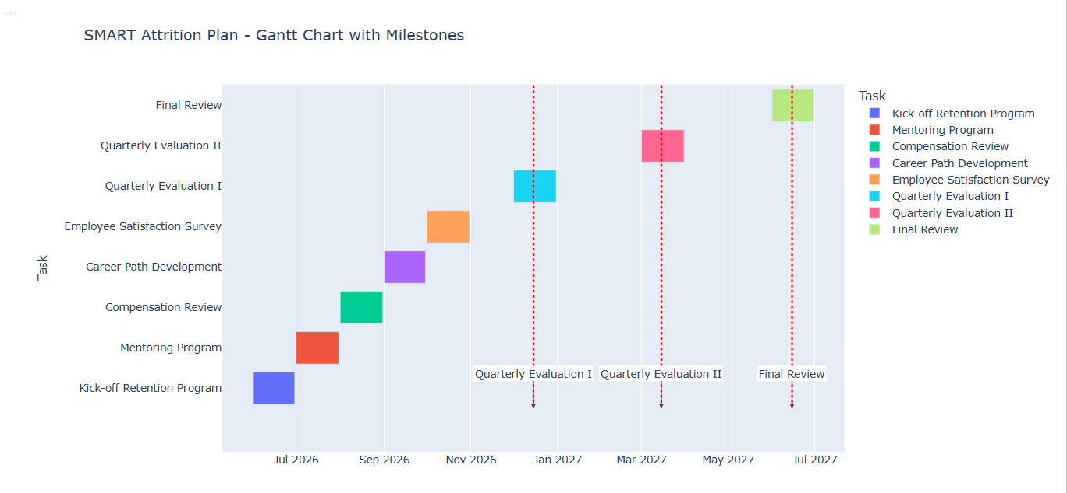
Business Problem
International Business Machine (IBM) Corporation attrition rate is 16.1% per year, exceeding the company’s target of ≤ 10%. The organization will reduce attrition to ≤ 10% within 12 months by implementing measurable and relevant employee retention programs, including mentoring, compensation review, and career path development, with quarterly progress evaluations.

Slide 7
KPI / Objective Analysis
Indicator | KPI Score | Target | Objective Analysis
Attrition Rate | 16.12% | < 10% | Employee turnover is significantly above the target. HR Managers and Management need intensive retention programs, especially in departments with the highest attrition.
Employee Lifetime Value (ELV) | Stayed (No): 7.37 years Left (Yes): 5.13 years | Stayed (No): > 5 years Left (Yes): < 2 years | Employees who stayed already meet the target (> 5 years), but those who left stayed too long (5 years vs. target < 2 years). HR Managers and Management need strategies to identify at-risk employees earlier.
Average Commute Threshold | 10.63 km | < 15 km (ideal) | The average commute distance is still within acceptable limits, but monitoring is needed since long commutes can increase attrition.
Salary Competitiveness Ratio | 1.00 | ≥ 1.0 | The ratio is equal to the company average. However, further analysis by education level is needed: bachelor’s degree (S1) employees tend to be under-indexed compared to master’s/PhD (S2/S3).
Overtime Impact Ratio | 2.93 | < 2.0 | The risk of resignation increases almost threefold for employees working overtime. HR Managers and Management need to implement work-life balance policies and ensure fair workload distribution.

Slide 8
KPI / Objective Analysis
Indicator | KPI Score | Target | Objective Analysis
Average Tenure in Role (Promotion Lag) | Average tenure in current role: 4.23 years Average years since last promotion: 2.19 years | Current role: < 3 years Promotion: ≤ 2 years | Employees remain too long in the same role. Delayed promotions can reduce motivation. HR Managers and Management need clearer career paths.
Income to Job Level Ratio | HR = $2.7 – $3.8 R&D: $2.8 – $3.8 Sales: $2.5 – $3.8 | Ideal ratio: ≥ 1.0 | Analysis is needed to ensure compensation aligns with job level. If the ratio is < 1.0, it indicates a gap between salary and job level.

Slide 9
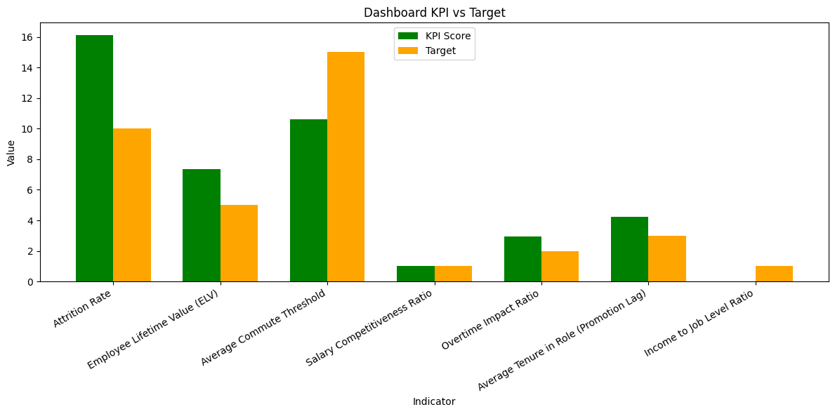
KPI / Objective Analysis
Link Interaktif

Slide 10
Hyphothesis
Problem | Strategic | Hypothesis | Hypothesis Statement | Testing Variables (X ➔ Y)
Attrition Rate IBM 16.12% (Target ≤ 10% dalam 12 Bulan | New Hire Retention | H1: Weak Manager Relationship | Early Attrition. A short working relationship with the direct manager triggers high early attrition among new hires. | X: YearsWithCurrManager < 2 years Y: JobInvolvement & Attrition
 | Fair Remuneration | H2: Pay Below Job Level Ratio | Low Job Satisfaction. A pay-to-job-level ratio that falls below the department average decreases job satisfaction and drives voluntary turnover | X: Income_to_JobLevel_Ratio Y: JobSatisfaction & Attrition
 | Career Progression | H3: Stagnant Promotion (Lag) | Career Stagnation The longer the time elapsed since the last promotion, the higher the risk of attrition due to perceived career stagnation. | X: YearsSinceLastPromotion Y: YearsInCurrentRole & Attrition
 | Work-life Balance | H4: Overtime + Long Commute | Acute Burnout. he combination of mandatory overtime and a long commute (> 10.63 km) creates a compounding burnout effect. | X1: OverTime ('Yes') + X2: DistanceFromHome Y: WorkLifeBalance & Attrition

Slide 11
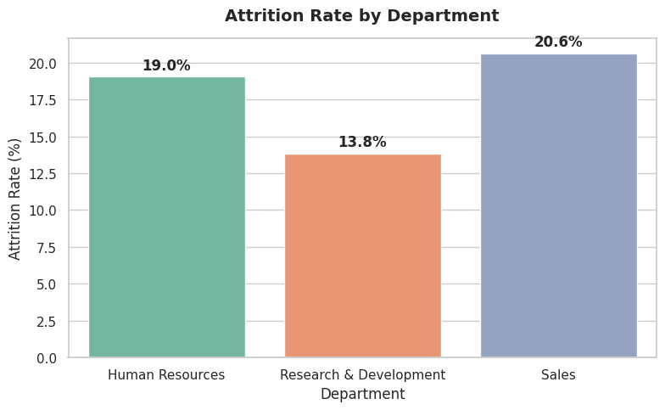
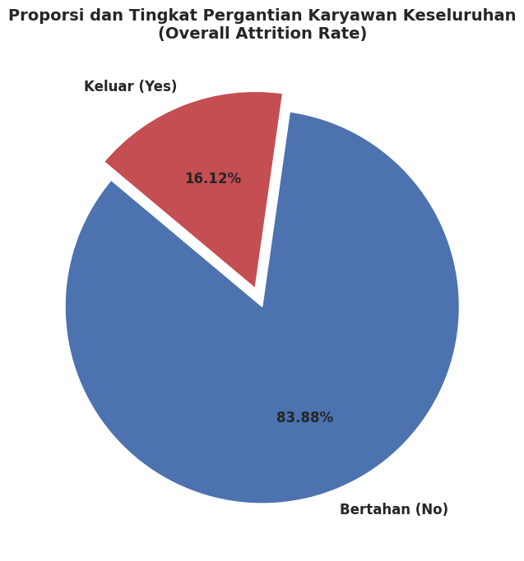
Analysis
While IBM’s overall attrition rate is 16.1%, turnover is disproportionately concentrated in departments such as Sales. Targeted retention programs in these areas are essential to stabilizing workforce performance and align with industry benchmarks
Insight Business:
IBM’s annual attrition rate of 16.12% is above the global benchmark of 10–12%, placing the company in a caution zone. Immediate HR interventions are required to stabilize workforce retention and align with industry standards

Slide 12
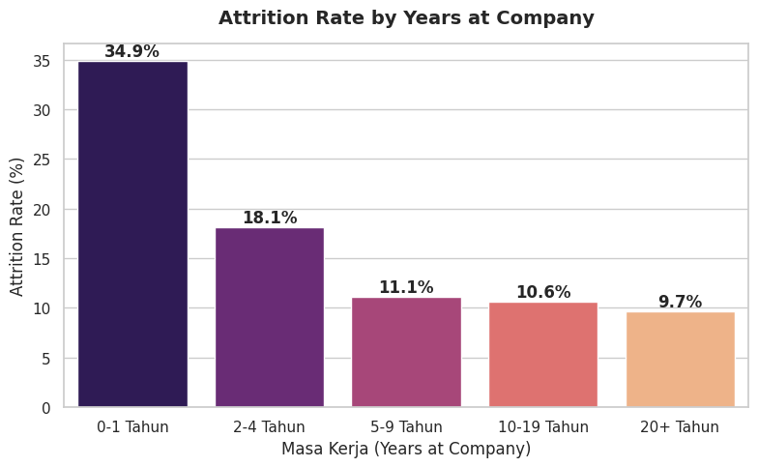
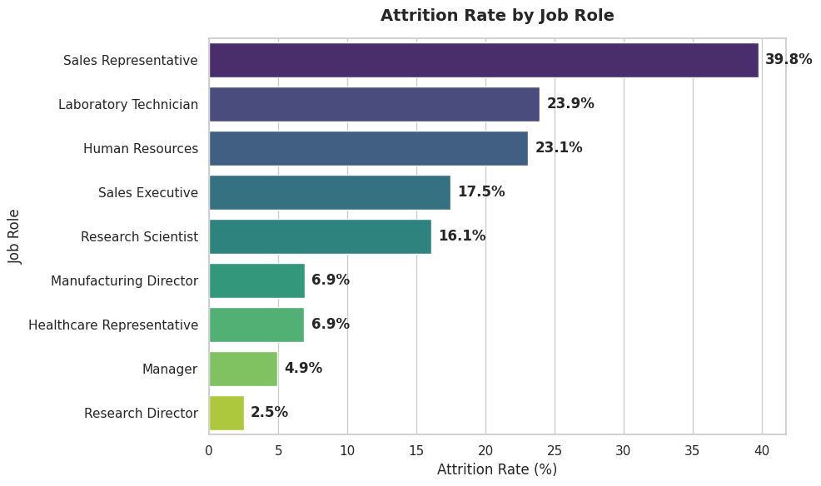
Analysis
Interpretation:
Attrition is highest among employees in their first year (34.9%) and then declines after the second year. This underscores the critical need for targeted retention strategies during the early employment phase

Slide 13
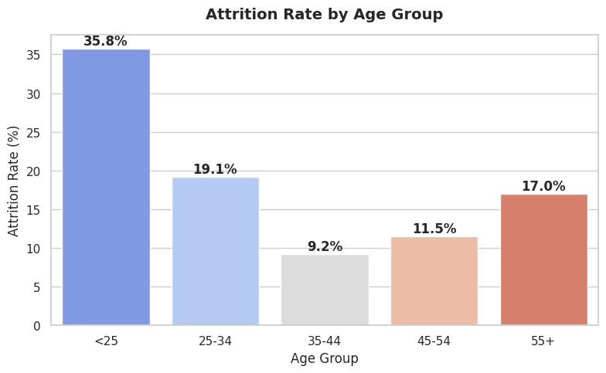
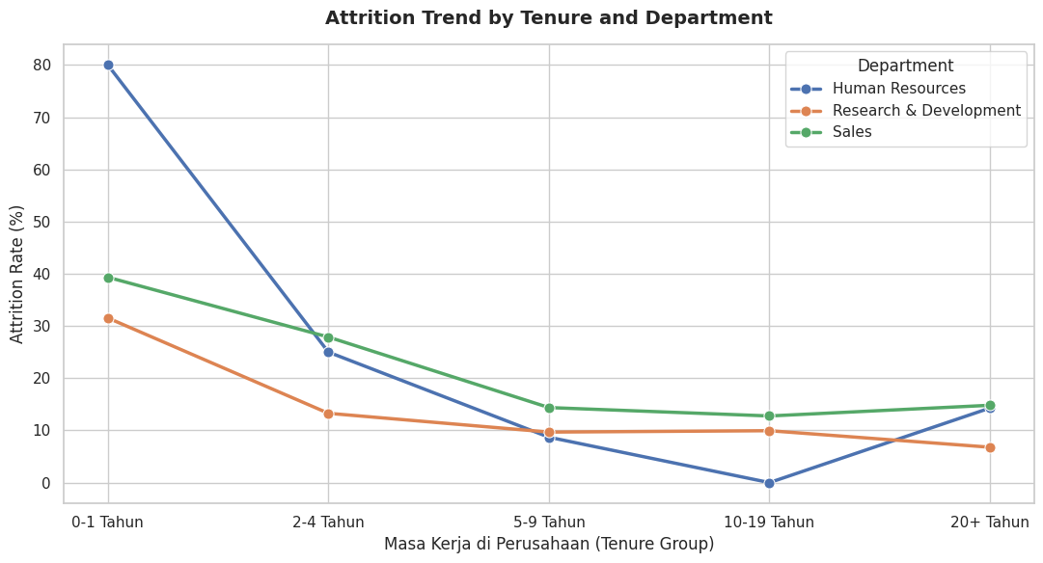
Analysis
Interpretation:
Angka ini mengindikasikan adanya masalah besar pada fase awal pengalaman kerja (Early Employee Experience).
Karyawan di bawah 25 tahun biasanya merupakan fresh graduates atau karyawan tingkat awal (entry-level). Tingginya angka keluar ini umumnya disebabkan oleh:
Proses ekspektasi kerja yang tidak selaras saat onboarding.
Kurangnya bimbingan personal (mentoring) di awal karier.
Pencarian kompensasi instan atau kultur kerja yang lebih fleksibel di luar perusahaan.

Slide 14
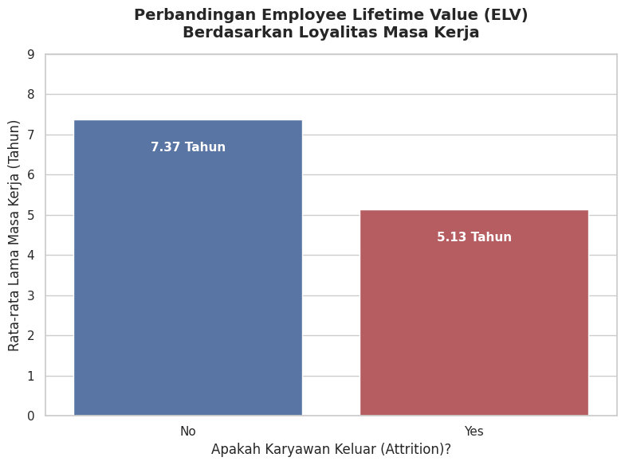
Analysis
=== ANALISIS EMPLOYEE LIFETIME VALUE (ELV) === Status Attrition Rata-rata Masa Kerja (Tahun) No 7.369019 Yes 5.130802 ---------------------------------------------- Karyawan yang keluar (Yes) rata-rata resign pada tahun ke-5.13. Perusahaan kehilangan potensi loyalitas waktu sebesar 2.24 tahun per karyawan dibandingkan dengan kelompok yang bertahan (No). =============================================

Slide 15
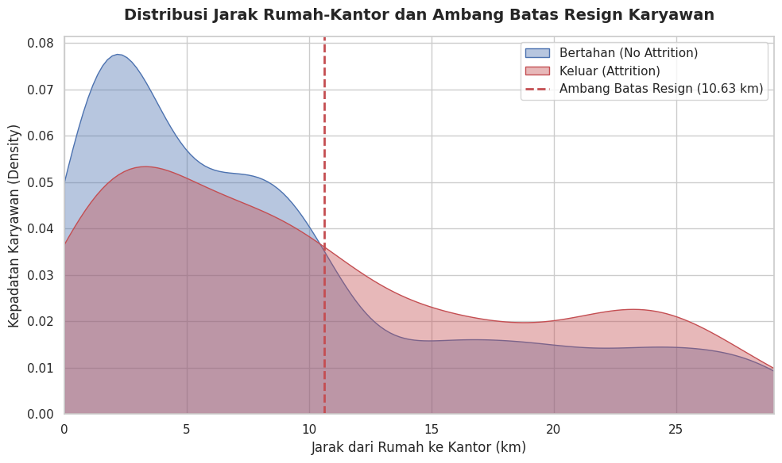
Analysis
=== ANALISIS AMBANG BATAS RATA-RATA PERJALANAN === Status Attrition Rata-rata Jarak (km) No 8.915653 Yes 10.632911 -------------------------------------------------- Ambang Batas Perjalanan (Commute Threshold) Karyawan Resign: 10.63 km. Karyawan yang keluar memiliki jarak rumah-kantor rata-rata 1.72 km lebih jauh dibandingkan mereka yang memilih untuk bertahan.
Business Insight:
The company can use the 10 km threshold as a benchmark for policy planning. Employees commuting beyond this distance may be prioritized for shuttle services, transportation allowances, or flexible work arrangements, subject to manufacturing operational feasibility.

Slide 16
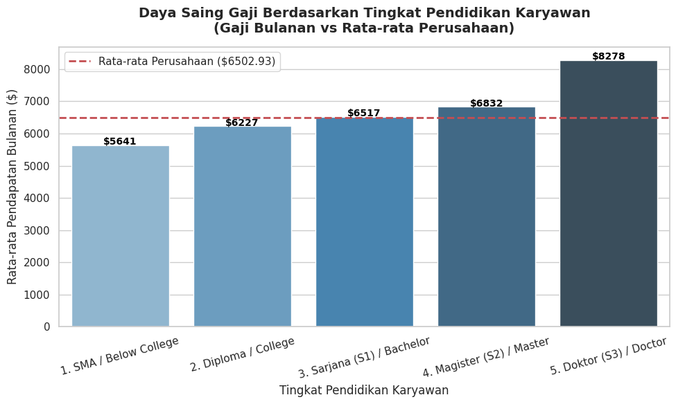
Analysis
=== ANALISIS DAYA SAING GAJI INTERNAL === Rata-rata Gaji Perusahaan (Semua Karyawan) : $6502.93 Rata-rata Gaji Lulusan Sarjana (S1) : $6517.26 -------------------------------------------------- Rasio Daya Saing Gaji Karyawan S1 : 1.00 Artinya: Gaji lulusan S1 berada di angka 100.2% dari rata-rata gaji perusahaan. ========================================= Detail Rata-rata Gaji per Jenjang Pendidikan: Education_Level MonthlyIncome 1. SMA / Below College 5640.570588 2. Diploma / College 6226.645390 3. Sarjana (S1) / Bachelor 6517.263986 4. Magister (S2) / Master 6832.402010 5. Doktor (S3) / Doctor 8277.645833
Business Insight:
Salary ratios highlight how education level impacts compensation positioning. While S1 employees may cluster at entry-level pay, advanced degrees (S2/S3) often align with higher-value roles. HR can use this benchmark to design fair pay structures, ensure career progression pathways, and balance compensation equity across educational backgrounds.
Interpretation:
A ratio of 1.0 means the average salary of bachelor’s degree (S1) employees is exactly equal to the overall company average.
A ratio below 1.0 (e.g., 0.98 or 0.99) indicates that S1 salaries are slightly lower than the company average. This is common when most S1 employees are in entry-level or junior roles, while managerial positions (which raise the overall average) are held by master’s (S2) or doctoral (S3) graduates.
The red dashed line on the chart acts as a benchmark, showing which education levels are over-indexed (above average pay) and which are under-indexed (below average pay).

Slide 17
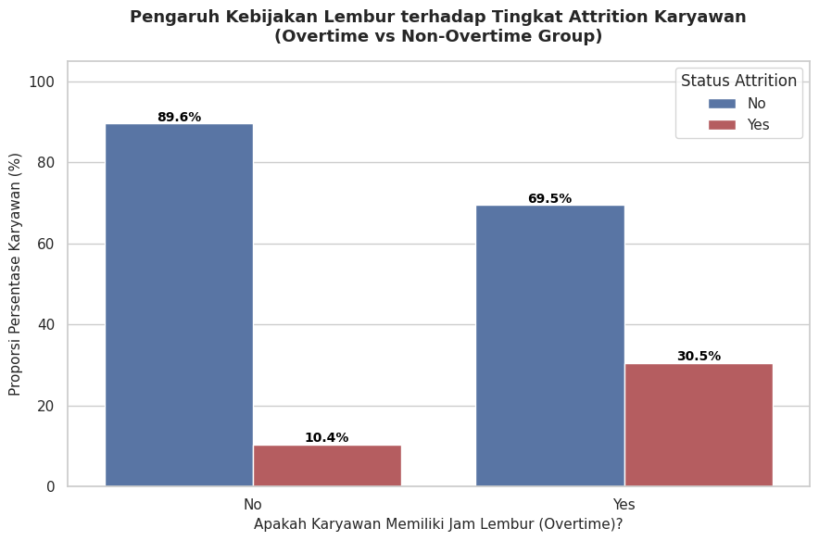
Analysis
=== ANALISIS RASIO DAMPAK KERJA LEMBUR (OVERTIME IMPACT RATIO) === Tingkat Attrition pada Karyawan Lembur (Overtime = Yes) : 30.53% Tingkat Attrition pada Karyawan Biasa (Overtime = No) : 10.44% ------------------------------------------------------------------ Rasio Dampak Kerja Lembur (Overtime Impact Ratio) : 2.93x Lipat Artinya: Karyawan yang lembur memiliki risiko keluar 2.9 kali lebih besar dibandingkan dengan mereka yang jam kerjanya normal. ==================================================================
Interpretation
ratio value of 2.93x — nearly threefold — indicates that overtime is not just a secondary factor but the most critical driver of employee attrition in IBM manufacturing. The data reveals a sharp increase in attrition, reaching 30.5% among employees with overtime workloads
Business Insight:
HR and operations management should treat overtime as a critical risk factor.
Recommended actions include:
Setting monthly overtime limits to prevent excessive workloads.
Auditing overtime pay fairness to ensure compensation aligns with effort.
Implementing healthier shift rotations to reduce burnout and maintain workforce stability

Slide 18
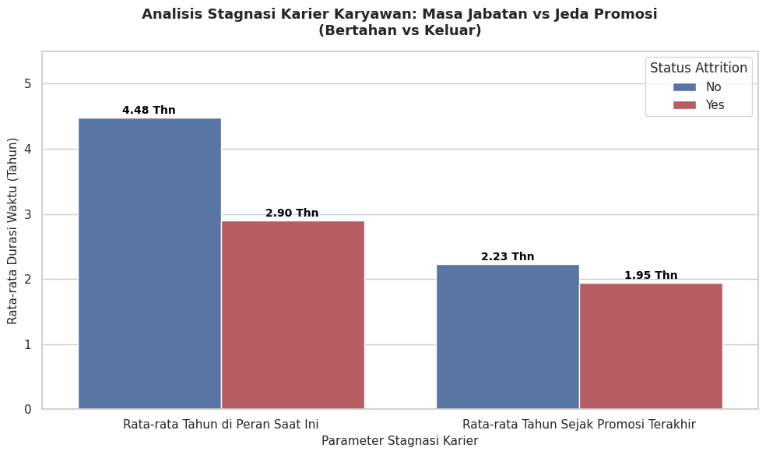
Analysis
=== ANALISIS STAGNASI KARIER & TENURE (PROMOTION LAG) === Rata-rata Waktu Karyawan di Posisi yang Sama : 4.23 Tahun Rata-rata Waktu Sejak Promosi Terakhir : 2.19 Tahun ----------------------------------------------------------------- Detail Perbandingan Berdasarkan Attrition: Status Attrition Rata-rata Tahun di Peran Saat Ini Rata-rata Tahun Sejak Promosi Terakhir No 4.484185 2.234388 Yes 2.902954 1.945148
Interpretation
Actual Role Tenure (YearsInCurrentRole): Employees who leave average 2.9 years in their current role, while those who stay average 4.5 years. This indicates early-tenure attrition, where turnover risk is highest in the 2nd–3rd year of a role not due to long term bored, but challenges in early adaptation.
Promotion Gap (YearsSinceLastPromotion): Both groups show similar promotion wait times 2.2 years for those who stay versus 2.0 years for those who leave. This suggests that promotion delays are not the primary driver of attrition
Business Insight:
The key issue is role adjustment in the first 2–3 years, not long-term career stagnation. HR should focus on:
Strengthening mentorship programs to support employees during early tenure.
Conducting job satisfaction reviews around the mid-point of the second year.
Improving role onboarding and integration to reduce early attrition risk.

Slide 19
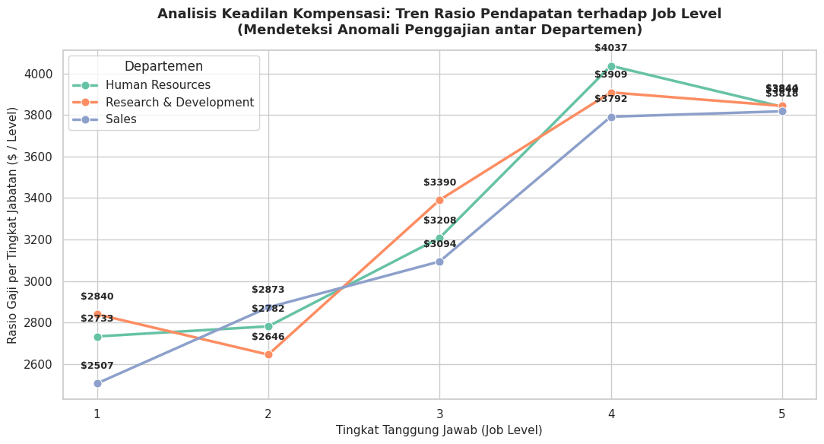
Analysis

Slide 20
Analysis
Key Finding – HR Department (Job Level 5)
In Human Resources, the pay ratio at Job Level 4 is $4,036 per level, but at the highest level (Job Level 5) it drops to $3,839 per level.
This means senior HR leaders (Senior Director/VP) are paid proportionally less for the extra responsibilities compared to Job Level 4. This reflects a clear case of internal inequity.
Industry Pattern – U-Shaped Curve
cross most departments (especially R&D and Sales), pay ratios rise sharply at Job Levels 3 & 4, then flatten or slightly decline at Job Level 5.
This shows that the biggest compensation boost happens when employees move into upper-mid levels (3 & 4), while top-level roles don’t always see proportional increases.
Strategic Insight
Review senior-level pay structures to ensure fairness.
Leverage mid-level promotions as key motivators.
Align compensation with responsibility to prevent inequity and disengagement.
=== ANALISIS INCOME TO JOB LEVEL RATIO PER DEPARTEMEN === Department JobLevel MonthlyIncome Income_to_JobLevel_Ratio Human Resources 1 2,733.21 2,733.21
Human Resources 2 5,563.46 2,781.73
Human Resources 3 9,623.00 3,207.67
Human Resources 4 16,147.50 4,036.88 Human Resources 5 19,197.86 3,839.57 Research & Development 1 2,840.06 2,840.06 Research & Development 2 5,291.24 2,645.62 Research & Development 3 10,170.49 3,390.16 Research & Development 4 15,634.68 3,908.67 Research & Development 5 19,218.51 3,843.70 Sales 1 2,506.72 2,506.72
Sales 2 5,746.05 2,873.03
Sales 3 9,282.29 3,094.10 S
ales 4 15,166.26 3,791.57
Sales 5 19,088.00 3,817.60 =========================================================
Business Insight:
HR and leadership teams should recognize that mid-level promotions deliver the strongest sense of reward for employees. At the same time, senior-level pay structures need review to ensure fairness and prevent inequity at the top

Slide 21
Insight Summary
Indicator | Data | Insight | Recomendation
Attrition Rate (status: Alert) | 16.12% (Company target $\le 10\%$ | The corporation is losing talent too rapidly and is currently operating in the retention danger zone. | Compensation adjustments or performance-based incentives should be targeted at high-risk roles such as Sales Representatives and Laboratory Technicians to mitigate early-career attrition
Critical Turnover Window (ELV) | Terminated employees leave at an average of 5.13 years, while retained employees stay for 7.37 years. | Year 5 is the critical drop-off point. Retention interventions must be tightened before employees hit this tenure threshold.
Distance from Home (Commute Threshold) | The average commute distance for employees who resigned is 10.63 km | Commutes exceeding 10 km trigger high physical fatigue and act as a highly sensitive turnover catalyst. | Use the 10 km commute threshold as a benchmark for transport subsidies or shuttle services. Explore flexible work arrangements where operationally feasible to reduce logistical strain
Bachelor's Salary Competitiveness Ratio | Ratio of 1.02 (Bachelor's degrees earn 2% more than the company average) | Pay for Bachelor’s graduates is internally competitive. The root cause of attrition lies in workload or positioning rather than education-level pay gaps
Overtime Impact | Attrition risk surges 2.93x higher for employees who work overtime | The primary driver of burnout. Management must immediately audit workload distribution and scale back excessive overtime. | Since overtime increases turnover risk up to 30.5%, the company should audit workloads, distribute tasks more evenly, or add part-time/contract staff when production capacity rises

Slide 22
Insight Summary
Indicator | Data | Insight | Recomendation
Career Stagnation (Promotion Lag) | Employees spend an average of 4.23 years in the same role, with a promotion lag of 2.19 years. | Talents are experiencing role fatigue and feeling stuck in a routine due to prolonged stagnation in the exact same position. | High turnover under certain managers signals the need for people management training for supervisors to improve workplace comfort and retention.
Pay vs. Responsibility Anomaly (Income to Job Level Ratio) | Internal compensation inequities were detected at the highest organizational tier (Job Level 5) across two departments HR and R&D | Human Resources (HR): Primary Anomaly. Level 4 pay ($4,036/level) is proportionally higher than Level 5 pay ($3,839/level). HR Directors are effectively underpaid relative to their burden of responsibility. Research & Development (R&D): Secondary Anomaly. Exhibits a similar inverted pattern, where Level 5 ratio ($3,843/level) drops below Level 4 ($3,908/level). Sales: Stable & Healthy. Compensation grows linearly and equitably with each step up the job level ladder. | Execute an immediate Compensation Review for Job Level 5 within the HR and R&D divisions to mitigate the severe risk of top-leadership attrition.

Slide 23
STRATEGIC RECOMMENDATIONS FOR
HR DASHBOARD (12 Months)
Indicator | Priority | Recomendation
Burnout Mitigation | 1 | Batasi kuota lembur bulanan per karyawan, terutama bagi mereka yang memiliki metrik logistik kritis (jarak rumah > 10.63 km).
Executive Compensation Review / Adjustment | 2 | Sesuaikan kembali upah dasar Job Level 5 di HR dan R&D agar rasionya berada di atas level 4 (minimal $4,100/level) guna menjaga asas keadilan internal.
Job Rotation | 3 | Lakukan rotasi kerja lateral atau job enrichment sebelum karyawan menyentuh angka masa kerja 4 tahun di peran yang sama (YearsInCurrentRole) untuk menghindari kejenuhan karier.

Slide 24
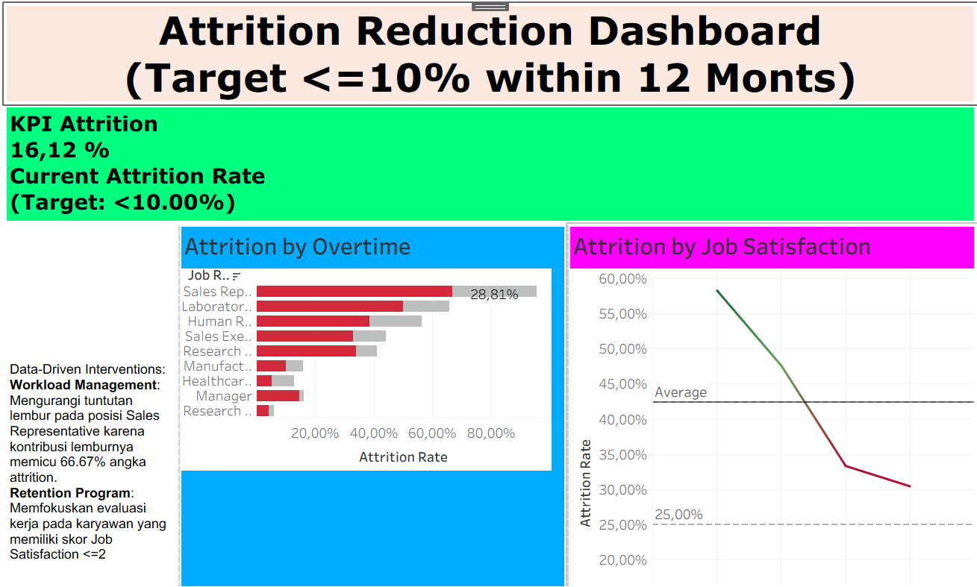
Dashboard
Dashboard link

Slide 25
Appendix
Data Set
Data Cleaning
Google Colaboratory
Linkedin
Additional information

Slide 26
Thank You

